Slide 1
Introduction to Internet

Slide 2
Content
What is Internet?
Evolution and history of Internet
Growth of Internet
Owners of Internet
Internet services
How does the internet works?
Anatomy of Internet
Internet Addressing
Internet vs Intranet
Impact of Internet
Governance of Internet

Slide 3
What is Internet?
The Internet is a worldwide interconnected network of hundreds of thousands of computers of various types that belong to multiple networks.
Internet is a global network that connects billions of computers across the world with each other and to the World Wide Web.
It uses standard internet protocol suite (TCP/IP) to connect billions of computer users worldwide.
It is set up by using cables such as optical fibers and other wireless and networking technologies.
At present, internet is the fastest mean of sending or exchanging information and data between computers across the world.
* TCP - Transmission Control Protocol
* IP - Internet Protocol

Slide 4
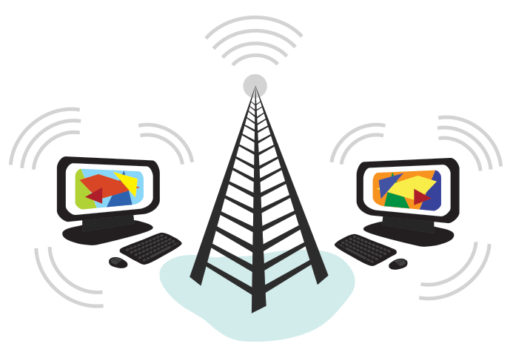
Internet is different from the World Wide Web as the World Wide Web is a network of computers and servers created by connecting them through the internet.
So, the internet is the backbone of the web as it provides the technical infrastructure to establish the WWW and acts as a medium to transmit information from one computer to another computer. It uses web browsers to display the information on the client, which it fetches from web servers.
The World Wide Web—usually called the Web for short—is a collection of different websites you can access through the Internet.

Slide 5
Evolution and history of Internet
The first question that pops into your mind is probably, “Who started the internet?”. The Internet started in the 1960s as a way for government researchers to share information.
Computers in the '60s were large and immobile and in order to make use of information stored in any one computer, one had to either travel to the site of the computer or have magnetic computer tapes sent through the conventional postal system.
The Internet was developed by Bob Kahn and Vint Cerf in the 1970s. They began the design of what we today know as the ‘internet.’ It was the result of another research experiment which was called ARPANET, which stands for Advanced Research Projects Agency Network. This was initially supposed to be a communications system for the Defense Team of the United States of America - a network that would also survive a nuclear attack.

Slide 6
It eventually became a successful nationwide experimental packet network. But when was the first Internet started? It is believed that on 6 August 1991, when the World Wide Web opened to the public.
ARPANET uses packet-switching technology. Packet-switching means that bits of information can take virtually any route and still end up at its final destination. For example, think about where you live and then think about the different ways to get your local supermarket.
You can a take the long route or the short route. You can take back roads, streets or even the highway. There is no real set way to get to your destination, as long as you get there. This is the same concept as packet-switching technology.

Slide 7
Growth of Internet
The Internet came into existance in the late 70's as an outgrowth of the ARPANET, a DOD project.
Since its creation in 1983, the Internet has grown exponentially in terms of numbers of networks connected to it. By 1985, 100 networks, both public domain and commercial utilizing TCP/IP protocol suite became available.
By 1987, the number had grown to two hundred; in 1989, it exceeded five hundred and by the end of 1991, the Internet had grown to include some 5,000 networks in over 36 countries, serving over 700,000 host computers used by over 4,000,000 people.

Slide 8
Internet is continuously spreading day and night all over the world. The internet community is making the world community literate all over the world, or a common person, who is related to interconnecting information technology or working with technology.
At present, more internet resources are being used on desktops, laptops, and cell phones. Where multiple internet users are managing global information through local and global network technology connections.
Where the internet has become more popular among professionals, engineers, laymen, individuals, students, even all global communities, etc.
Nowadays most of the work is done with the help of computer technology, artificial intelligence, or a machine. As such, after the use of the internet in computer technology, it becomes more popular with information easily accessible.

Slide 9
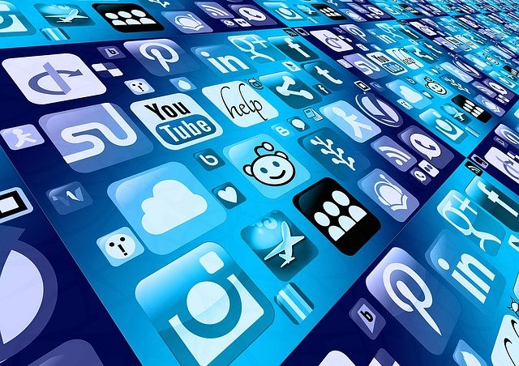
Where as of June 2012 internet users were 2336 million 33.3 percent of the world’s population. And it is now increasing in great size every day now. Which is being used by anyone for their commercial and non-commercial purpose.

Slide 10
Owners of Internet
So who actually owns the Internet? There are two answers to this question:
Nobody
Lots of people
If you think of the Internet as a unified, single entity, then no one owns it. There are organizations that determine the Internet's structure and how it works, but they don't have any ownership over the Internet itself.
No government can lay claim to owning the Internet, nor can any company. The Internet is like the telephone system -- no one owns the whole thing.

Slide 11
From another point of view, thousands of people and organizations own the Internet. The Internet consists of lots of different bits and pieces, each of which has an owner. Some of these owners can control the quality and level of access you have to the Internet. They might not own the entire system, but they can impact your Internet experience.
The physical network that carries Internet traffic between different computer systems is the Internet backbone. In the early days of the Internet, ARPANET served as the system's backbone. Today, several large corporations provide the routers and cable that make up the Internet backbone. These companies are upstream Internet Service Providers (ISPs). That means that anyone who wants to access the Internet must ultimately work with these companies, which include:
UUNET
Level 3
Verizon
AT&T
Qwest
Sprint
IBM

Slide 12
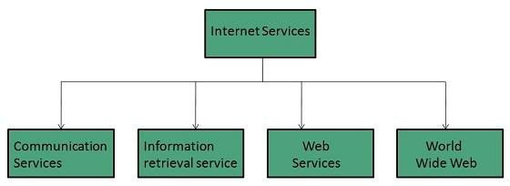
Internet services
Internet Services allows us to access huge amount of information such as text, graphics, sound and software over the internet.

